Slide 1

RAMRAO ADIK INSTITUTE OF TECHNOLOGY
Department of Computer Engineering (AIML)
TE Mini Project Presentation
On
“Deception Detection”
By
Roll No. 22AM1023 Aman Singh
Roll No. 22AM1013 Babita Sheoran
Roll No. 22AM1075 Nirav Kadam
Roll No. 22AM1125 Mythri Patel
Guided by
Dr. Shubhangi Ghate

Slide 2


Deception Detection

Slide 3
Outline
Introduction
Literature Survey of the existing systems
Limitations of the existing systems
Problem statement
System Design
Algorithm
Results & Evaluation
Technologies and methodologies
Conclusion
References
SE Mini Project Mock Presentation

Slide 4
Introduction
Deception Detection Model addresses the pervasive issue of decepetive news proliferating through social media and other media platforms.
Using traditional machine learning models, a supervised machine learning algorithm is developed that effectively classifies news articles as either true or false.
The model utilizes tools such as Python’s Scikit-learn and natural language processing (NLP) for textual analysis & systematic methodology for feature extraction and selection.
It involves gathering a labelled dataset and applying different classification methods to evaluate their performance, ultimately aiming to enhance the accuracy of various systems.
SE Mini Project Mock Presentation

Slide 5
Literature Survey of the existing systems:
Several studies on deception detection use ML and NLP, ranging from traditional models like Naïve Bayes to deep learning methods like BERT. Key focus areas include feature extraction (TF-IDF, n-grams) and improving contextual understanding for accurate fake news classification
These are a few ML approaches for deception detection:
1. Traditional Machine Learning
Models like Logistic Regression, SVM, Decision Trees, and Naïve Bayes have been widely used.
These rely on manually extracted features such as word frequency, n-grams, and sentiment scores.
Naïve Bayes, despite its simplicity, performs well in spam filtering and basic text classification.
SE Mini Project Mock Presentation

Slide 6
Literature Survey of the existing systems:
2. Deep Learning Techniques
Neural networks, including CNNs, analyze sentence structure and word embeddings.
Transformer-based models (e.g., BERT, GPT) capture deeper contextual relationships, improving classification accuracy.
These models are particularly effective for understanding subtle cues in language.
3. NLP-Based Feature Extraction
NLP is central for converting raw text into usable model input.
Techniques like Tokenization and TF-IDF transform unstructured text into structured numerical vectors.
These features help models detect deception based on linguistic patterns.
SE Mini Project Mock Presentation

Slide 7
LIMITATIONS OF EXISTING SYSTEM
1. Data Quality & Bias
Models need large, high-quality, and up-to-date labeled datasets.
Many available datasets are biased, affecting real-world accuracy.
2. Contextual Understanding
Traditional ML models focus on word frequency and patterns but struggles with sarcasm and nuanced misinformation.
Deep learning models like BERT handle context better but are resource-intensive.
3. Evolving Fake News Tactics
Fake news constantly changes in form and language.
Static models can’t keep up—continuous learning is essential.
4. Overreliance on Source Credibility
Some systems judge reliability by source, which isn’t always accurate.
Even reputable sites can publish misleading content, and fake sites can appear credible.
SE Mini Project Mock Presentation

Slide 8
Problem Statement
The main objective of this study is to develop an efficient and accurate deception detection system using supervised machine learning techniques.
Given the limitations of existing systems, our proposed solution aims to:
Improve accuracy by selecting the best machine learning models for classification.
Enhance feature extraction using advanced NLP techniques to capture linguistic patterns.
Increase adaptability to detect new forms of deception as they emerge.
Reduce computational complexity to ensure scalability for real-world applications.
SE Mini Project Mock Presentation

Slide 9
Technologies and Methodology:
Programming Language :
Python is chosen due to its extensive libraries and support for machine learning.
Machine Learning Libraries
Scikit-learn for implementing machine learning algorithms.
NLTK for text preprocessing and NLP tasks.
Feature Extraction Techniques
TF-IDF (Term Frequency-Inverse Document Frequency):
Measures word importance in a document relative to a dataset.
Word Embeddings (Word2Vec):
Captures semantic relationships between words.
Evaluation Metrics
Accuracy: Measures overall correctness.
Precision & Recall: Helps in identifying false positives and false negatives.
F1-score: Balances precision and recall for a better assessment of model performance.
SE Mini Project Mock Presentation

Slide 10
System Design
Data Collection:
News articles (real and fake) were collected from public datasets like Kaggle.
Text was cleaned using preprocessing techniques such as:
  Removing special characters
  Eliminating stop words
  Applying stemming (Porter-Stemmer)
2. Feature Extraction:
Tokenization: Text split into individual words.
TF-IDF Vectorization: Converts text into numerical form based on term importance across documents.
3. Model Training:
Used Logistic Regression as the classification algorithm.
Trained on TF-IDF features to distinguish between real and fake news articles.
4. Performance Evaluation:
Evaluated using metrics like Accuracy, Precision, Recall, and F1 Score.
Achieved 97.91% accuracy on test data, indicating reliable generalization.
SE Mini Project Mock Presentation

Slide 11
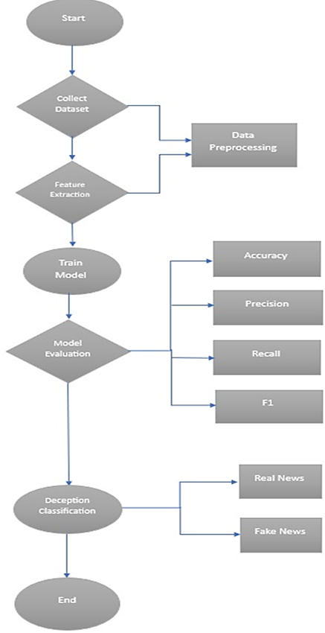

System Design Flowchart
SE Mini Project Mock Presentation

Slide 12
Algorithm
Start:
Initialize required libraries: NumPy, Pandas, NLTK, Scikit-learn
Load Dataset:
1) Import labeled news articles (real/fake)
2) Fields include: title, text, author, label
Preprocess Data:
1) Convert to lowercase
2) Remove punctuation/special characters
3) Remove stop-words (example: “is”, “the”)
4) Apply stemming (example: running → run)
5) Combine relevant fields (example: title + author)
SE Mini Project Mock Presentation

Slide 13
Algorithm
4. Feature Extraction:
Use TF-IDF Vectorizer to convert text to numerical vectors
Model Training:
1) Split data: 80% training, 20% testing
2) Train using Logistic Regression
Model Evaluation:
Evaluate on test data using Accuracy, Precision, Recall, F1-score
Prediction:
Classify new/unseen news articles as Real (0) or Fake (1)
End
SE Mini Project Mock Presentation

Slide 14
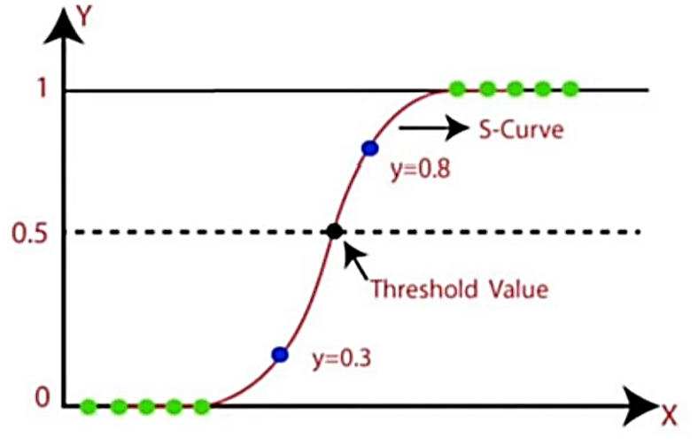
Results & Evaluation
Model Used:: Logistic Regression
Dataset: Labeled real & fake news articles
(from Kaggle and similar sources)
Accuracy:
Training Accuracy: 98.63%
Test Accuracy: 97.91%
Indicates strong generalization without overfitting
F1 Score:
Training F1 Score: 0.986
Test F1 Score: 0.979
Balanced precision & recall —
handles both real and fake classifications well
Formula for logistic regression using sigmoid function:
σ(z)=1+e−z1​
Where;
σ(z) → the output of the sigmoid function (a value between 0 and 1)
z=wT(x)+b → linear combination of input features x, weights w, and bias b.
SE Mini Project Mock Presentation

Slide 15
Future Scope
1. Use of Advanced AI Models
We can improve our system by using smarter AI models like BERT or GPT. These understand language better, so they can catch more subtle fake news.
2. Real-Time Fake News Checking
The system can be connected to the internet (e.g., using APIs) to check articles instantly as users read them—just like spell-check but for truth!
3. Multiple Languages
Right now, the model might only work in English. In the future, it could also detect fake news in regional or foreign languages using language-specific tools.
4. Detecting Across Platforms
Instead of only checking news websites, the system can be expanded to scan for fake posts on Twitter, Facebook, WhatsApp, etc.
5. Explainable AI (XAI)
We want the system to also explain why it thinks an article is fake. This helps people trust the tool and understand its decision.
SE Mini Project Mock Presentation

Slide 16
Conclusion:
This project highlights the potential of combining machine learning and NLP to detect fake news with high accuracy. Using TF-IDF for feature extraction and Logistic Regression for classification, the system effectively identifies deceptive content. While the current model performs well, future improvements could include integrating deep learning for better context understanding and enabling real-time detection across platforms and languages.
SE Mini Project Mock Presentation

Slide 17
Thank You!

